Slide 1





Stock Market Forecast
Name : ANTOVIN S Guide: P. RAJA, Master Trainer
NM ID : au913321114003
Disclaimer: The content is curated for educational purposes only.
Notes:
Slides: Prepare a short slide deck (10-12 slides) summarizing the project objectives, methodology, and key results.

Slide 2
OUTLINE
Abstract of the Project
Problem Statement
Proposed Solution
System Architecture
Live Demo of the Project
Embedded Video of Project
Conclusion
Future Scope

Slide 3
Abstract
Stock market forecasting is a critical aspect of financial analysis, aiding investors in making informed decisions and optimizing portfolio management. This project explores the application of linear regression, a statistical technique, to predict future stock prices based on historical data. By analyzing key variables such as past stock prices, trading volume, and other market indicators, we develop a linear regression model aimed at uncovering trends and patterns in stock price movement. Our methodology involves data preprocessing, feature selection, and model training using historical stock data, followed by validation and testing to evaluate prediction accuracy. While linear regression is a relatively straightforward approach, it provides valuable insights into short-term price movement and helps illustrate the influence of linear relationships within financial data. The results of this project demonstrate the effectiveness and limitations of linear regression for stock price forecasting, setting a foundation for further exploration with more complex models to enhance predictive accuracy in volatile financial markets.

Slide 4
Problem Statement
Accurately forecasting stock prices is a complex challenge due to the highly volatile and unpredictable nature of financial markets.
Investors and analysts rely on predictive models to make data-driven decisions, but existing models often struggle to deliver consistent accuracy amidst market fluctuations.
This project aims to address the problem of short-term stock price prediction by leveraging linear regression techniques to analyze historical stock data.
Specifically, the project seeks to determine if linear regression can effectively capture patterns and relationships within historical price data to predict future stock prices with a reasonable level of accuracy.
By assessing the predictive capacity of linear regression, this study intends to provide insights into the model's utility and limitations in the context of stock price forecasting.

Slide 5
Proposed Solution
Collect historical stock price data and relevant influencing factors.
Clean and preprocess the data by handling missing values, scaling features, and splitting the dataset into training and testing sets.
Choose the factors that you believe influence stock prices.
Use a linear regression model to build your prediction model.
Train the model using your historical data.
Evaluate the model’s performance on the testing set to see how well it predicts stock prices.
Use the trained model to make predictions on future stock prices.
Analyze the predictions and compare them with actual stock prices to assess the model’s accuracy.

Slide 6
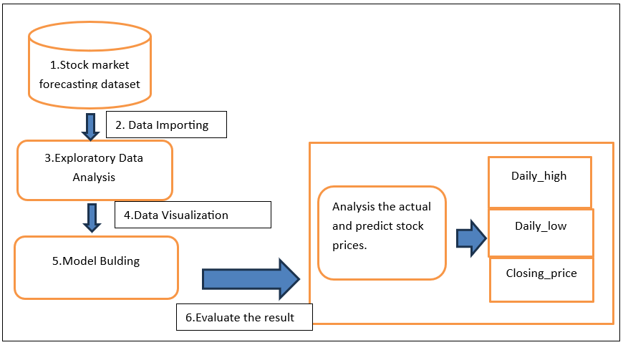
System Architecture

Slide 7
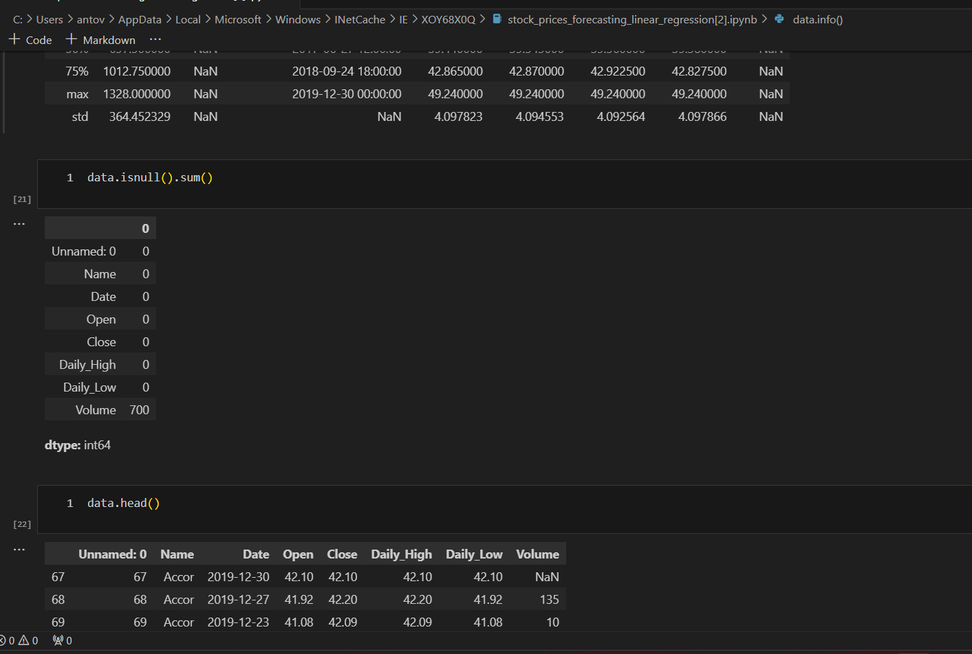
Live Demo of Project

Slide 8
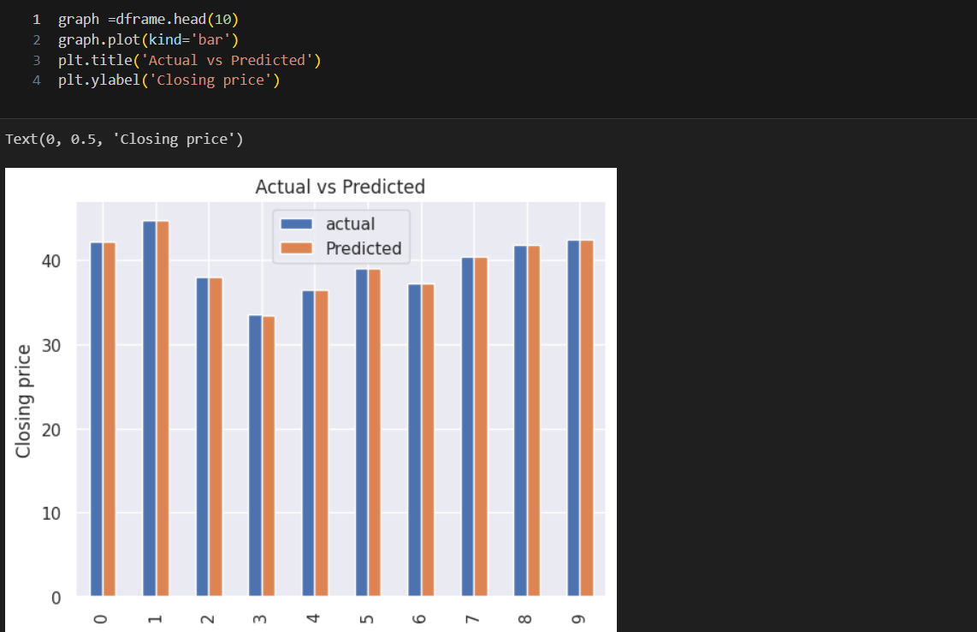
Video of Project Demo

Slide 9
Conclusion
Stock market forecasting using linear regression provides a straightforward and interpretable approach to understanding price trends and relationships with market features. However, its simplicity is both its strength and its limitation. Linear regression assumes a linear relationship between predictors and stock prices, which works well in stable and trend-following markets but struggles with volatile and non-linear dynamics inherent in financial data. Key findings indicate that linear regression performs reasonably well for capturing general trends but lacks the sophistication to handle sudden price fluctuations or complex market interactions. Its reliance on stationary data makes preprocessing crucial, and even then, it often falls short in volatile environments.
In conclusion, while linear regression is not robust enough for high-stakes trading decisions, it provides a foundation for understanding basic stock price movements. Enhancements in feature engineering, data enrichment, and model selection can bridge the gap toward more accurate and reliable forecasting in the financial domain.

Slide 10
Future Scope
AI and ML algorithms are becoming increasingly sophisticated, allowing for more accurate predictions based on vast amounts of data.
With the explosion of data, big data analytics can process and analyze large datasets to identify trends and make predictions.
Analyzing the sentiment of news articles, social media posts, and other sources can provide insights into market sentiment and potential movements.
Blockchain can provide transparent and secure ways to record and verify transactions, which can improve the accuracy and reliability of financial data used in forecasting models.
Although still in its early stages, quantum computing has the potential to revolutionize stock market forecasting by solving complex problems much faster than traditional compurters.

Slide 11
Thank you!
Notes:
thank you very much for joining this PPT, keep learning.
11

